Slide 1
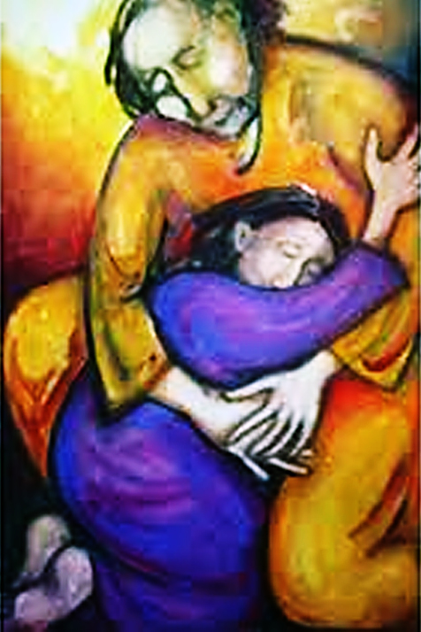
God Will Never Give Up on You

Slide 2
Note: Any videos in this presentation will only play online. After you download the slideshow, you will need to also download the videos from YouTube & add them back into your PowerPoint.
We present these messages at Bee Creek Park in College Station, TX. If you would like to watch the video of the service with this message, click here:
http://campaignkerusso.org/?p=5233
We would love to know more about the people who download our lessons & sermons. We invite you to email us & let us know where & how you use them.
info@ckbrazos.org

Slide 3
Let’s Begin with Prayer

Slide 4
God Will Never Give Up on You

Slide 5
The Parable of the Lost Son

Slide 6
“Finally, he came to his senses and said, ‘My father’s workers have plenty to eat, and here I am, starving to death!
I will go to my father and say to him, ‘Father, I have sinned against God in heaven and against you. I am no longer good enough to be called your son. Treat me like one of your workers.’
The younger son got up and started back to his father. →

Slide 7
“But when he was still a long way off, his father saw him and felt sorry for him. He ran to his son and hugged and kissed him.
The son said, ‘Father, I have sinned against God in heaven and against you. I am no longer good enough to be called your son.’
But his father said to the servants, ‘Hurry and bring the best clothes and put them on him. →

Slide 8
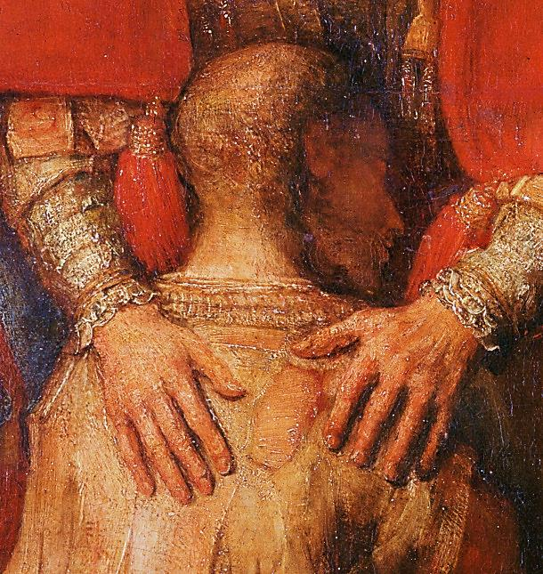
‘Give him a ring for his finger and sandals for his feet. Get the best calf and prepare it, so we can eat and celebrate.
This son of mine was dead, but has now come back to life.
He was lost and has now been found.’ And they began to celebrate.” Lk. 15:11-32

Slide 9
This Slide – Video: The Rebel, Now Your Child Download Here: http://www.youtube.com/watch?v=SZE9syAmKS0

Slide 10
This Slide – Song: Welcome Home Download Here: http://youtu.be/0UUQRxhbz2c

Slide 11
This Slide – Video: When God Ran! Download Here: https://youtu.be/Nf2MZRenJMU

Slide 12
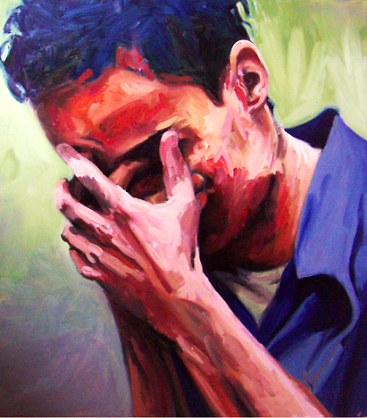
The Prodigal Son returned to his father and admitted his sin, but many feel too ashamed to return to God.
They feel unworthy of his love and forgiveness.
Notes:
But though we ARE unworthy, yet He still wants us back. God will never give up on you.

Slide 13
Video: God Will Not Turn Away From You
This Slide - Video:
In Your Hands →
Download Here:
https://youtu.be/p409zABeDSk

Slide 14
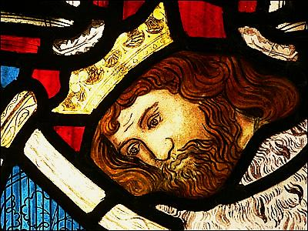
God Will Never Cut You Off
“As for me, I said in MY HASTE, ‘I am CUT OFF from before YOUR EYES.’ Nevertheless, YOU HEARD the voice of my petitions when I cried to you.” Psalm 31:22

Slide 15
Sometimes we feel that we are more likely to experience God’s wrath than His blessings.
Especially when things are going wrong -- we feel, “God has left the building.”
Notes:
Even when we can’t see or feel that there is any way back to God, Know that God will never give up on you.

Slide 16
For King David, nothing was worse than feeling CUT OFF from God
“All day and all night I cry and do not eat. All day my enemies say to me, "Where is your God?” Psalm 42:3
Notes:
I can imagine the so-called friends of the prodigal son, soon turned on him, saying where is that wonderful father of yours? But like the father God wants us to start the difficult journey back to where we belong, in His love and care.

Slide 17
David made a hasty mistake because he forgot… God’s arms are always open He never pushes the penitent away.
Jonah gave up too, then he had faith:
“Then I said, I am driven away from your sight; yet I shall again look upon your holy temple. Jonah 2:4
In truth, God waits & loves throughout our life. He is drawing us to Himself – never casting us off.
Notes:
God’s Arms are Always Open

Slide 18
God would do anything to save us. Now, as on the cross, His arms are always open.
On the cross, Jesus cried out to His Father in Heaven, “My God, My God, why have you forsaken me?”
Yes, we deserve to be cut off, but Jesus, the innocent, for the love of us, was cut off in our place!
Now his arms are ever open to all who will hear & come.
Notes:
God’s Eyes always see

Slide 19
David made a hasty mistake because he forgot… God’s Eyes Always See
Hagar was driven out by her mistress, Sarah, but, God saw & cared.
“So Hagar gave a name to the Lord who spoke to her. She called him, ‘You are a God who sees.’ She said, ‘I have really seen the God who sees me.’”
Genesis 16:13
Notes:
God’s ears always hear

Slide 20
David made a hasty mistake because he forgot… God’s Ears Always Hear
“Hezekiah turned his face to the wall and prayed to the LORD, "Remember, O LORD… and Hezekiah wept bitterly.” Isaiah 38:2-8
Then the word of the LORD came…
“I have heard your prayer and seen your tears”
God’s ears work fine, but He needs to hear our voices.

Slide 21
We are hasty in our thoughts of God but, God is not hasty in His thoughts of us.
If God were hasty, He would have scolded David for his unbelief, instead we read, “NEVERTHELESS you heard my voice!”
“The Lord is not slow to do what he has promised, as some think. Instead, he is patient with you, because he does not want anyone to be destroyed, but wants all to turn away from their sins.” 2 Pet. 2:9
God hears our cries and He knows the plans He has for us – not plans to cast us aside!
Before we say, “God has cut me off,” let us rather ask, “Would He give His only Son to save me and then give up on me?” NEVER!

Slide 22
When I cried unto Him!
His Arms are Open (not cutting us off)
His Eyes See & His Ears Hear
It is up to us, to call on Him & find Him!
Notes:
Let God speak to you, here, today!

Slide 23
Next Slide - Video: Love Letter From Our Father → Download Here: http://www.youtube.com/watch?v=6TcxA_7_fi8

Slide 24
Next Slide - Song: Amazing Love → Download Here: http://www.youtube.com/watch?v=uPeC6Pri_pM

Slide 25
Is Jesus
Speaking to You?
“They said to each other, ‘Did not our hearts burn within us while he talked to us on the road, while he opened to us the Scriptures?’”
John Wesley Said:
“…the preacher was describing the change which God works in the heart through faith in Christ and I felt my heart strangely warmed.”
Jesus makes His presence Known by a small voice!

Slide 27
What is the Sinner‘s Prayer?
This is a prayer we can pray when we are ready to admit we are sinners and need Christ’s forgiveness.
It must be prayed with faith in our hearts and a readiness to have a life-changing encounter with Jesus Christ.

Slide 28
A prayer of faith → Pray this prayer if :
If you never have before
You have in the past, but you think it would mean more today
You have been walking afar off and you want to come back
You want to set an example & show others how it is done
You just like to give your heart to Jesus again & again
Faith

Slide 29
We Declare Our Faith Publicly Because Jesus Declared His LOVE Publicly
“If you stand before others and are willing to say you believe in me, then I will tell my Father in heaven that you belong to me.” Mat 10:32

Slide 30
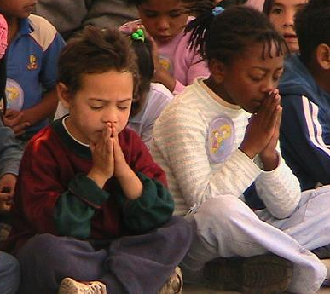
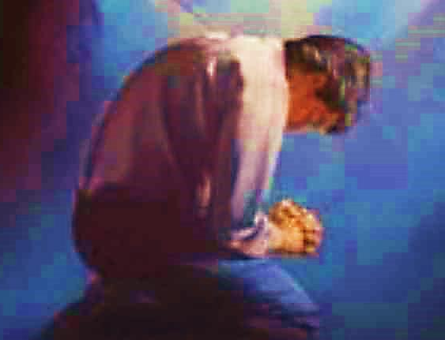
Three Important Questions
Do you want to know Jesus as your Savior right now?
Do you believe He died to save you from your sins & that He rose from the dead?
Do you believe that He is here, waiting to save you right now?

Slide 31
The Prayer of a Sinner Turning to Jesus
Dear Jesus, I know that I have sinned against You and that my sins separate me from You.
I am truly sorry.
Right now, I turn away from my sinful past .
Please forgive me, and help me to keep from sin.
I believe You died for my sins.
I Believe You rose from the dead, you are alive, and you hear this prayer from my heart.
I invite You Jesus to be both my Savior and the Lord of my life.
I want You to rule my life from now on.

Slide 32
“But some people did accept him. They believed in him, and he gave them the right to become children of God.”
John 1:12

Slide 34
“If you openly say, ‘Jesus is Lord’ and believe in your heart that God raised him from death, you will be saved.”
Rom. 10:9
What did you learn today?
What about God’s enduring love?
What have you been thinking about God lately?
What do you want to tell others about Jesus?

Slide 35
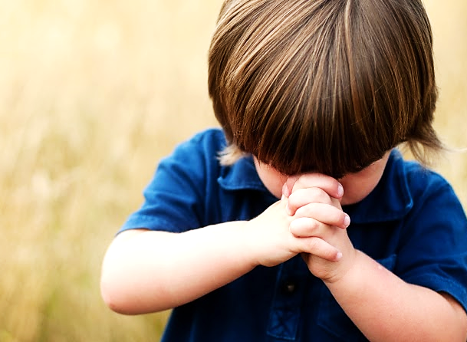
Let’s Close in Prayer

Slide 36
Note: Any videos in this presentation will only play online. After you download the slideshow, you will need to also download the videos from YouTube & add them back into your PowerPoint.
We present these messages at Bee Creek Park in College Station, TX. If you would like to watch the video of the service with this message, click here:
http://campaignkerusso.org/?p=5233
We would love to know more about the people who download our lessons & sermons. We invite you to email us & let us know where & how you use them.
info@ckbrazos.org

